Slide 1
Chapter 2
Motion in 1-D

Slide 2
Physical Quantities
Length, mass, time, force,
Speed, density, temperature
Current, magnetic field strength
Length, mass, time, force,
Speed, density, temperature
Current, magnetic field strength
Vectors and Scalars
Scalars magnitude
Vectors both magnitude
and direction

Slide 3
Vector
magnitude direction
To display a Vector
Vector Calculation
Vector Application

Slide 4

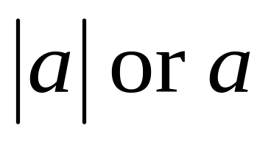

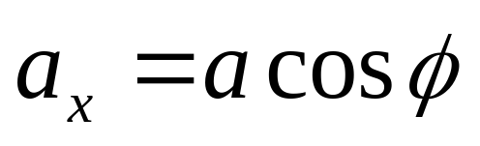
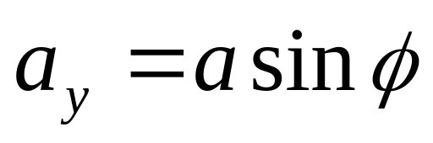
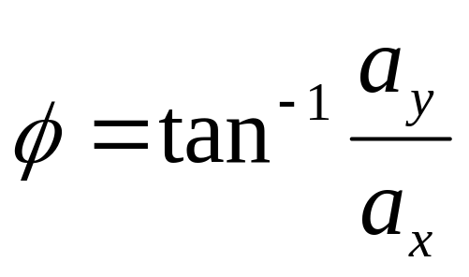
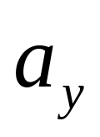
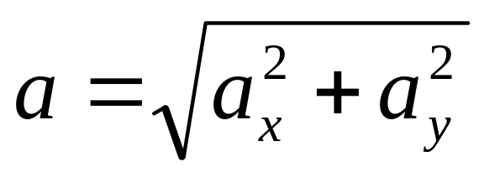

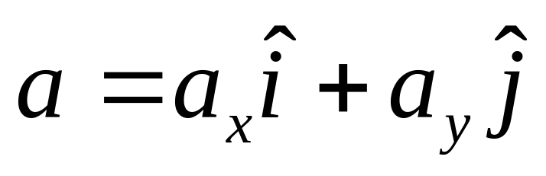
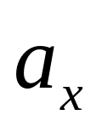

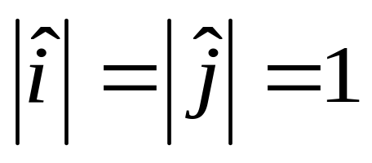
Properties of vectors
Direction
Magnitude
Unit vector

Slide 5
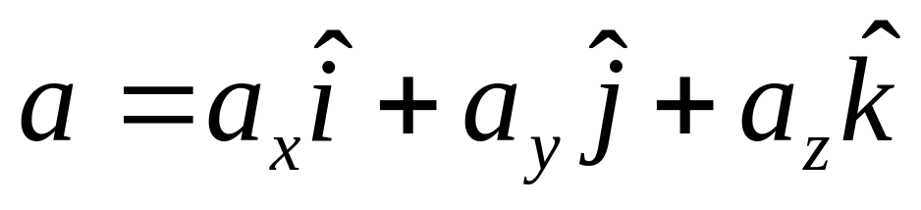

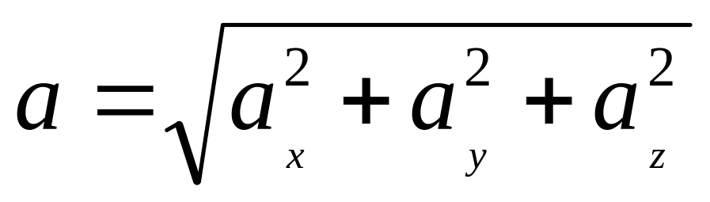
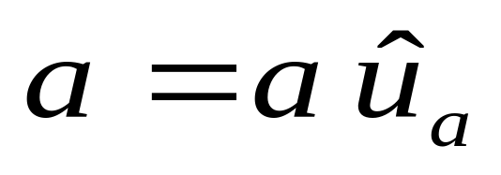


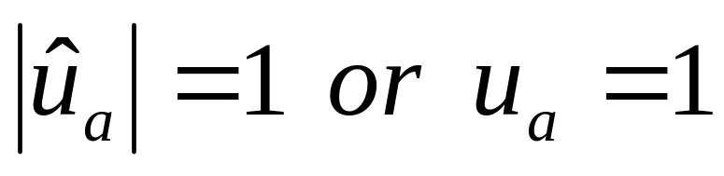
Three dimensions
a
a_{z}
Magnitude
a_{y}
a_{x}
unit vector

Slide 6
ADDING VECTORS
A+B = C
B
C
A
Making a Parallel Quadrilateral

Slide 7
ADDING VECTORS
A+B=C
B
C
B
A
Making a Triangle

Slide 8
F=A+B+C+D+E
E
D
F
C
B
A

Slide 9
A-B=C

Slide 10
A-B=C
A+(-B)=C
A=B+C
B
C
B
A
C
-B

Slide 11
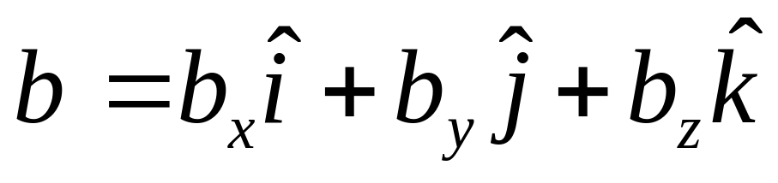
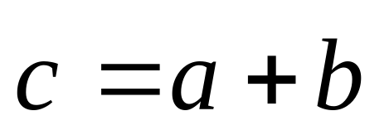
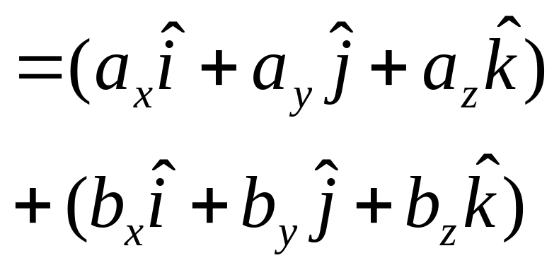
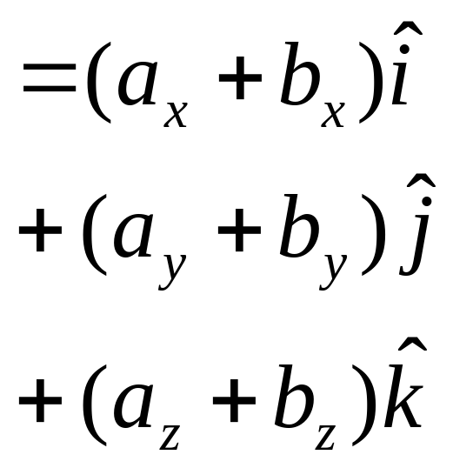
a
a_{z}
a_{y}
a_{x}

Slide 12
MULTIPLYING OF VECTORS
aB = C
vector
A.B = c
scalar
AxB = C
vector

Slide 13
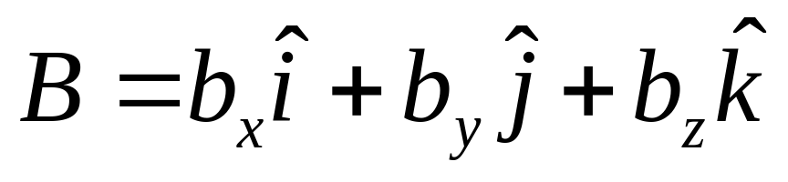
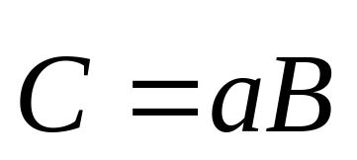
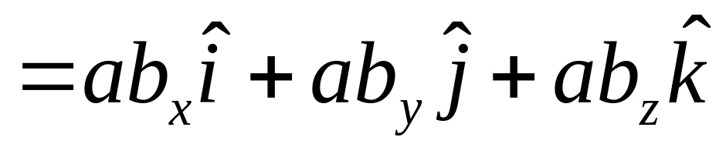
C
aB = C
B
Direction no change
Magnitude change

Slide 14
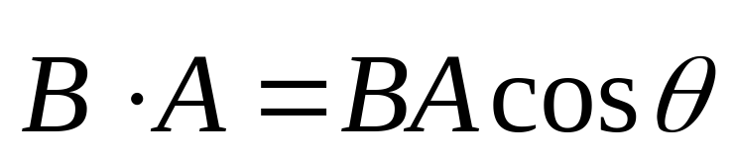
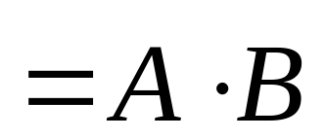
Multiplying of vectors
A.B = c
= A B cosθ
B
θ
A

Slide 15
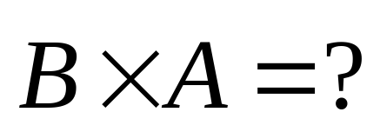
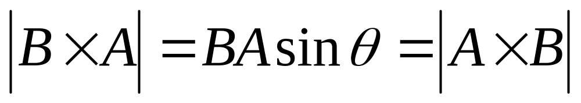
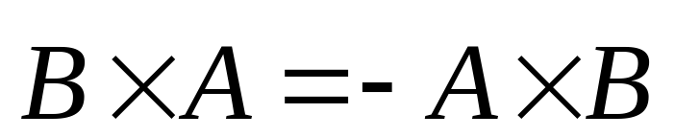
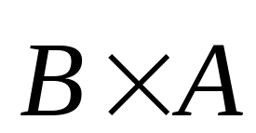
AxB = C
C = A B sinθ
C
B
θ
A

Slide 16
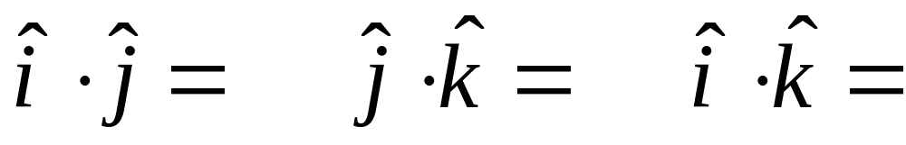
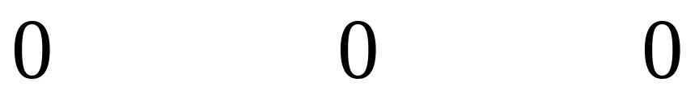
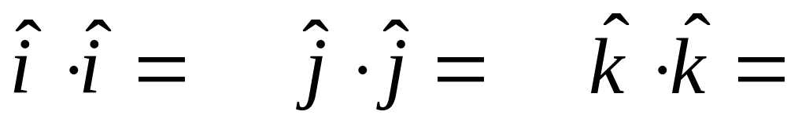

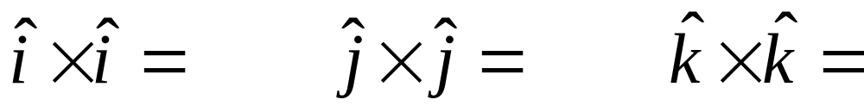
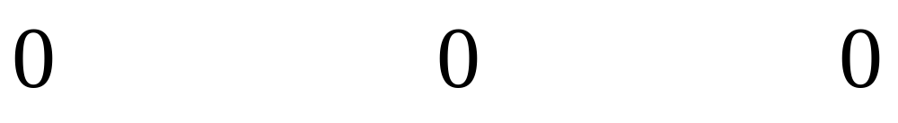
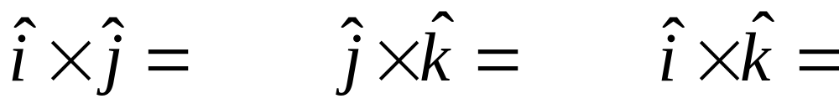
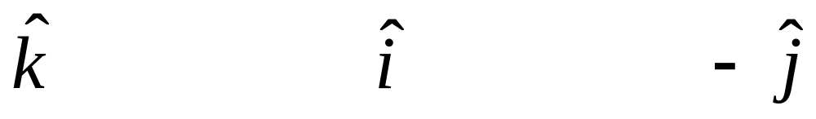

Slide 17
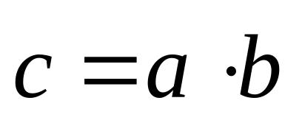
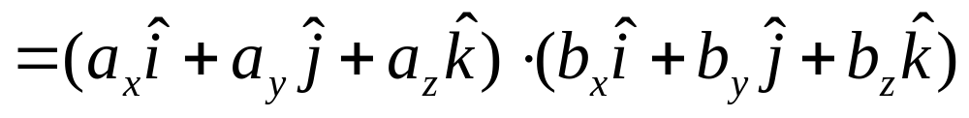
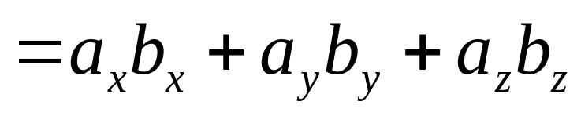
Multiplying of vectors

Slide 18
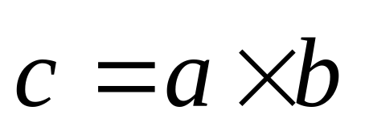
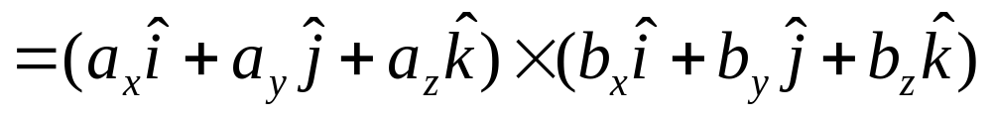
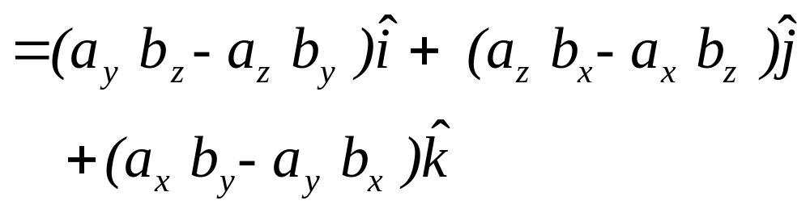
Multiplying of vectors

Slide 19
A+B = B+A
A.B = B.A
AxB = - BxA
(sA)xB=Ax(sB)=s(AxB)
A. (B+C)= A.B+ A.C
Ax (B +C) =AxB+AxC
A .(BxC)=B .(CxA)=C .(AxB)
Ax(BxC)=(A . C)B-(A . B)C

Slide 20
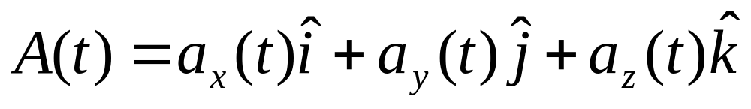
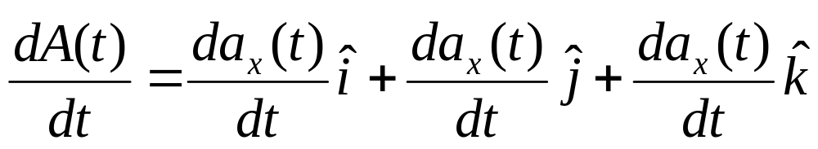
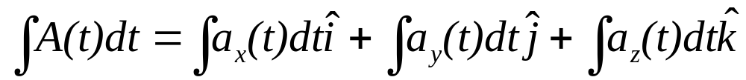
Derivation
Integral

Slide 21
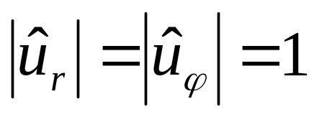

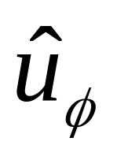
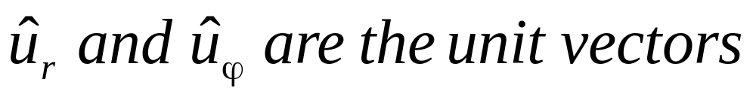
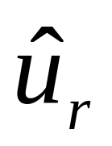
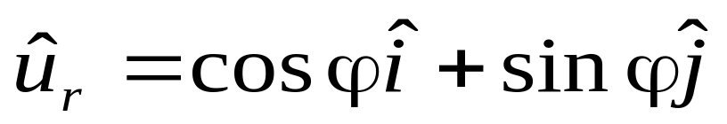
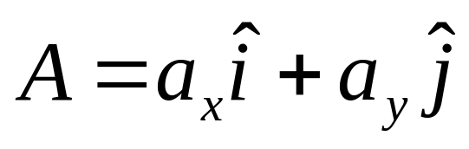
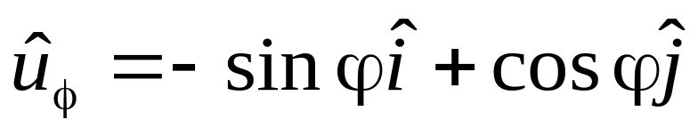


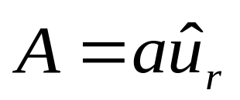










plane polar coordinates

Slide 22







plane polar coordinates
dφ

Slide 23
magnitude direction
Vector
To display a Vector
Vector Calculation
Vector Application

Slide 24
Example
F
θ
s
How to calculate the work?
W = F . s cos θ
W = F . s

Slide 25



How to display the rotation?
Example
ω
ω

Slide 26
Exercises
P34 6, 7, 8, 9, 10

Slide 27
N
(-1,2)
(1,1)
W
E
S

Slide 28




N
Difference of
(-1,2)
(1,1)
W
E
position vectors
is vector too
Displacement
S

Slide 29









Position, velocity and Acceleration
Displacement
r is function of time t: r=r(t).
z
position
Δr
r
y
Average Velocity
x
Instantaneous Velocity

Slide 30









Position, velocity and Acceleration
Displacement
z
position
Δr
r
y
Average acceleration
x
Instantaneous acceleration

Slide 31



Motion in one dimension
x(t)
0
x=x(t)

Slide 32






X=A+Bt+Ct²
X(t)
X=A+Bt
X=A
A
X=Dsin(ωt+φ)
t
0

Slide 33


x(t)
Slope at t₀
t₀
t
v(t)
Slope at t₀
t₀
t

Slide 34



Motion with constant acceleration
x=A+Bt+Ct²
x(t)
v(t)
Slope
Slope
t
t
a(t)
Slope=0
t

Slide 35











Motion with constant acceleration

Slide 36














Freely Falling Bodies

